Slide 1
SEED Fund
Collaborative Solar Procurement for Public Agencies
Solar Project Installation and Technical Considerations
June 2019

Slide 2
Presentation Agenda
Introductions
SEED Fund Overview
Overview of Technology and Installation Types
Feasibility Assessments and Design Considerations
Project Management and Commissioning
Operations and Maintenance
Next Steps
2

Slide 3
About Strategic Energy Innovations (SEI)
Strategic Energy Innovations inspires & empowers to advance solutions for a healthy, thriving planet.
Committed to empowering under-served markets
Schools, colleges, and universities
Local governments
Small and rural communities
Affordable housing providers and residents
Small businesses
…to embrace a climate-friendly future through green building, clean energy, resource efficiency and support of a local and qualified green workforce.

Slide 4
About Optony Inc.
Optony develops and deploys clean energy best practices across the entire project lifecycle for government agencies, schools, banks and commercial organizations. Optony has been involved in over 3GW of project activity globally from strategy to project commissioning.
Award Winning
Pubic Sector Project
Award Winning
Pubic Sector Project
Multiple Grant-Winner for Solar Market Transformation
Best of Silicon Valley Recognition for Energy Services
“Optony's consulting service is a must-have for any organization considering an investment in solar. Based on Optony’s comprehensive analysis and recommendations, we now have a low-risk, high-return solar strategy.”

Slide 5
About Sierra Business Council (SBC)
Sierra Business Council is an organization focusing on the environment, communities, and economies of the Sierra region. We’re a certified non-profit in both California and Nevada and have a 20-year history in the region.
Implements projects in several areas of expertise
Community planning
Natural area conservation and open space planning
Rural economic development
Collaborative process facilitation
Sustainable business practices
… to increase community vitality, economic prosperity, environmental quality, and social fairness in the Sierra Nevada.

Slide 6
The SEED Fund
Collaborative group procurement for solar PV to take advantage of economies of scale
Revolving fund addresses the barrier of upfront costs
3-step opt-in program to empower private and public agencies to evaluate solar PV projects and participate in collaborative procurement
Does not require upfront funds for project planning, site assessments, or procurement activities
Provides unbiased technical and financial analysis to help evaluate solar PV procurement options
If projects gain approval, vendors reimburse a small percentage of project cost to the SEED fund

Slide 7
SEED Fund Structure
SPONSOR
(CSI RD&D Grant; Previous Rounds of SEED Fund)
Multiple Rounds
Regional Collaborative Purchasing Initiative
Memorandum of Understanding
SEED FUND, LLC
PARTICIPANTS
VENDORS
OPTONY
SEI
Technical Assistance
Solar Contract
Reimbursement for Next Round of SEED Fund Procurement

Slide 8
Past Regional Rounds
8 Agencies in RFP
Led by County of Santa Cruz
34 total sites
12 MW considered; ~3 MW constructed; ~3 MW in negotiations
SEED Monterey Bay
SEED North Bay
13 Agencies in RFP
Led by City of San Rafael
32 total sites
4.3 MW constructed; 0.3 MW in design

Slide 9
Participation Timeline
Fall 2018-Summer 2019
Summer-Winter 2019
Spring 2020
Recruit Participants
Sign MOU
Assess Sites
Attend Workshops
Issue RFP & Review Responses
Sign Contracts
Build Projects
Decision Point 1
Decision Point 2
Decision Point 3

Slide 10
Potential Participants and Solar Development
Participants | Status | Recommended Sites | Solar Potential (kW)
City of South Lake Tahoe | Lead Agency | 5 | 557
City of Nevada City | MOU | 1 | 2,852
Tahoe Truckee Sanitation Agency | MOU | 1 | 5,562
Truckee Tahoe Airport District | MOU | 2 | 9,389
Nevada City School District | MOU | 4 | 497
Grass Valley School District | MOU | 4 | 500
Tahoe Donner Association | MOU | 5 | 1,100
South Tahoe Public Utility District | MOU? | 2 | 1,135
Town of Truckee | MOU? | 7 | 2,679
Lake Tahoe Unified School District | MOU? | 4 | 2,322
Bear Valley Business Association | MOU? | 4 | 383
County of Nevada | MOU? | 12 | 3,202
Others in consideration | ?
Total |  | 51 | 30,178

Slide 11
Major Changes in the Solar Industry
Recent Changes:
Major Impact On:
Dramatic Drop In Panel Prices
Consolidation In The Industry
New Financial Players In The Market
Maturing Industry (and market)
US Markets Are A Global Focus
Excess PV Capacity Coming Online
Grid Parity Accelerating (without incentives)
Better Project Economics
Few, Stronger Players
Lower Cost Of Capital
Better Results For Clients
Increased Competition
Must Seek Long-Term Stability
Mass Adoption Of Solar
11

Slide 12
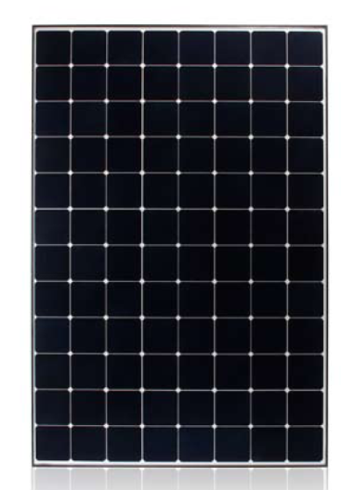
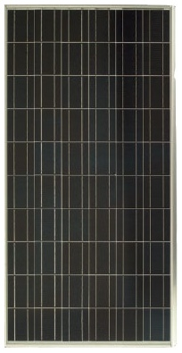
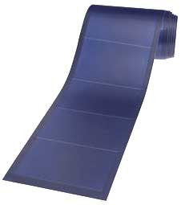
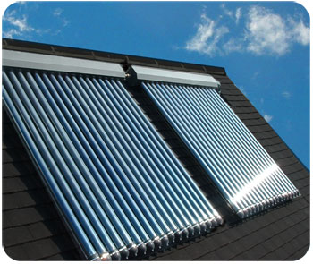
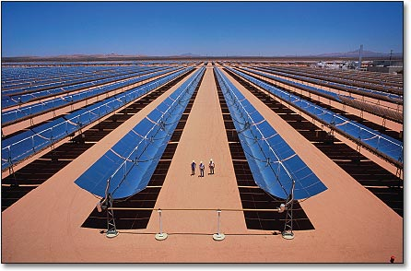
Overview: Solar Energy Technology Examples
Solar Photovoltaic (PV) Panels/Modules
Solar Hot Water
Utility Scale Concentrated Solar Farm
12
Notes:
12

Slide 13
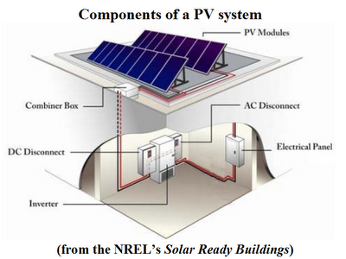
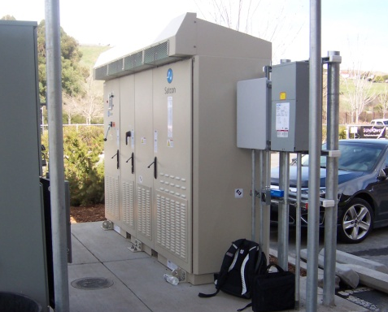
How Solar Works: Grid-Tied System
Example single day:
- Total energy generated: 1,172 kWh
- Total energy used: 1,093 kWh
13

Slide 14
Review of General Installation Types
Rooftop
Penetrating
Ballasted (Hybrid)
Standing-Seam
Laminate
Carport/Shade Structure
Fixed-tilt
Tracking
Ground-mount
Fixed-tilt
Tracking
Floating
Building-Integrated PV (BIPV)
14

Slide 15
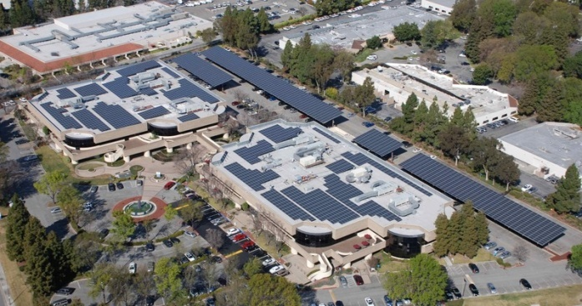
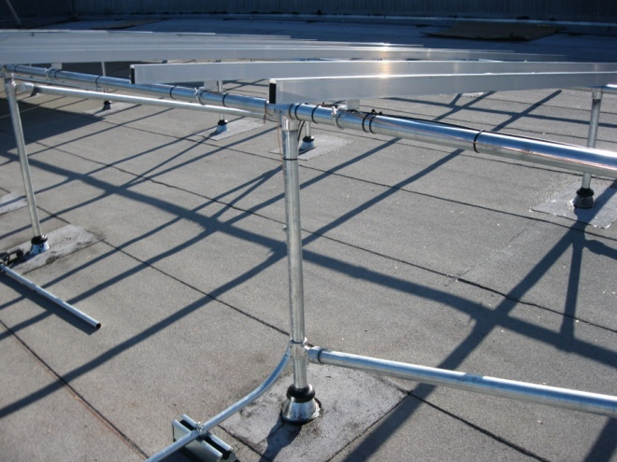
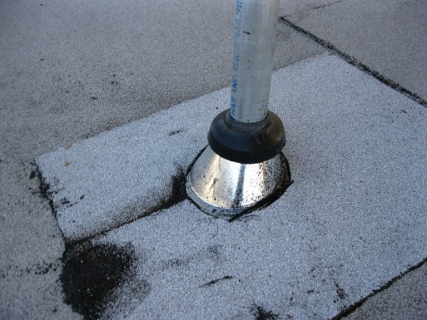
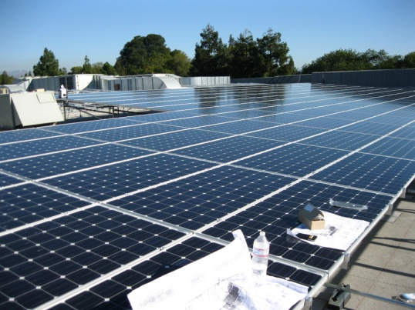
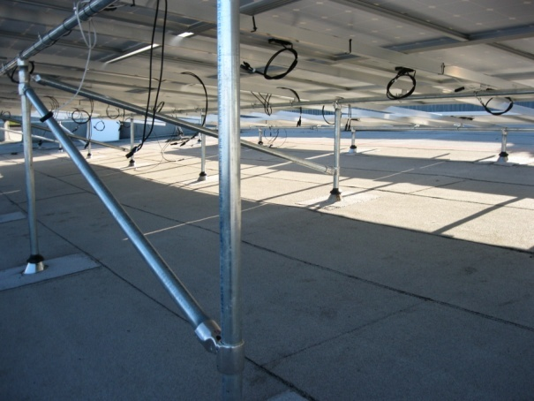
Installation Examples
Rooftop
Penetrating
Ballasted
Standing-Seam
Laminate
Carport/Shade Structure
Fixed-tilt
Tracking
Ground-mount
Fixed-tilt
Tracking
Floating
Building-Integrated PV (BIPV)
15

Slide 16
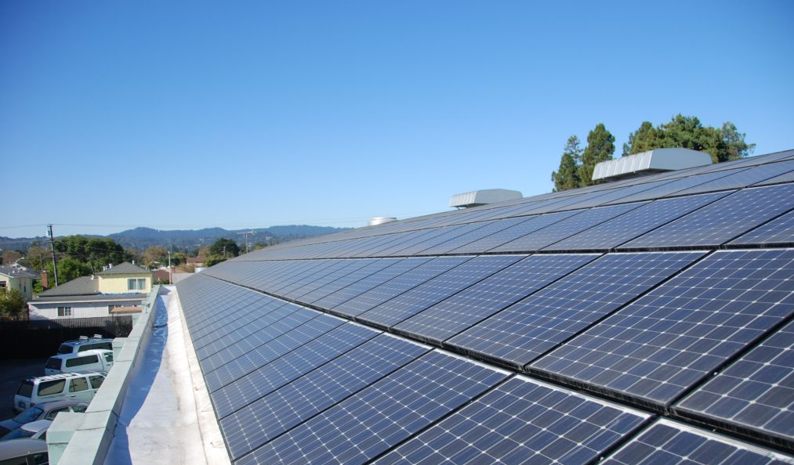
Example: Flush Mount Installation
16

Slide 17
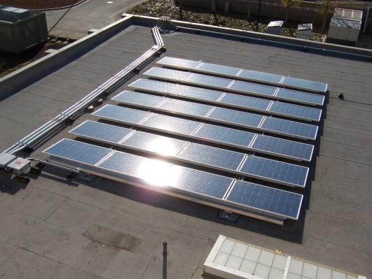
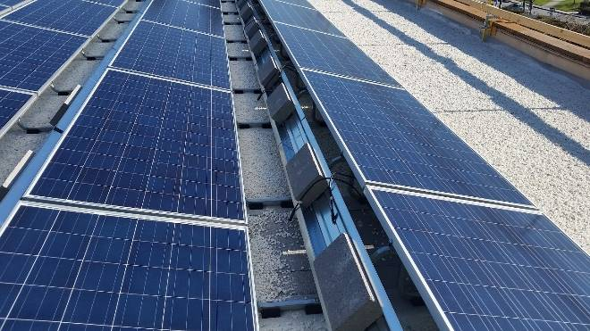
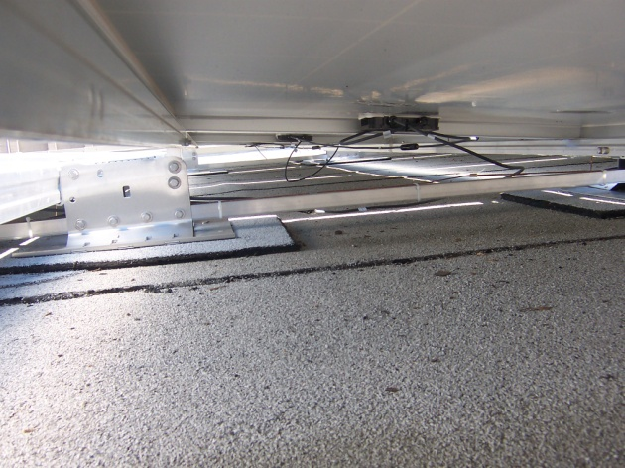
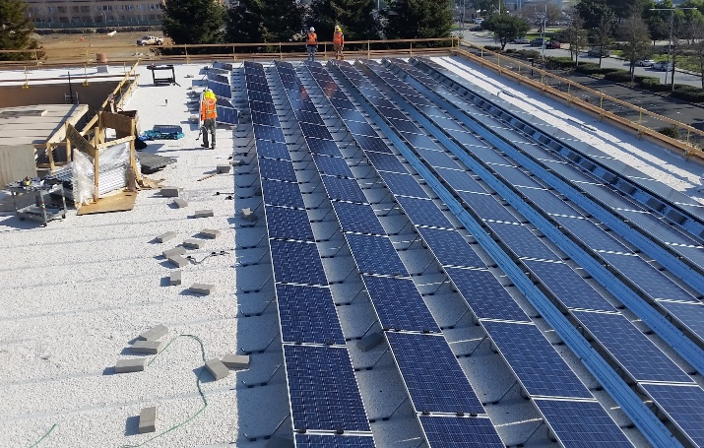
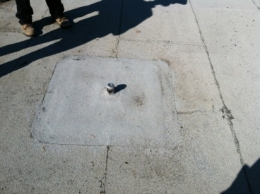
Installation Examples
Rooftop
Penetrating
Ballasted
Standing-Seam
Laminate
Carport/Shade Structure
Fixed-tilt
Tracking
Ground-mount
Fixed-tilt
Tracking
Floating
Building-Integrated PV (BIPV)
17

Slide 18
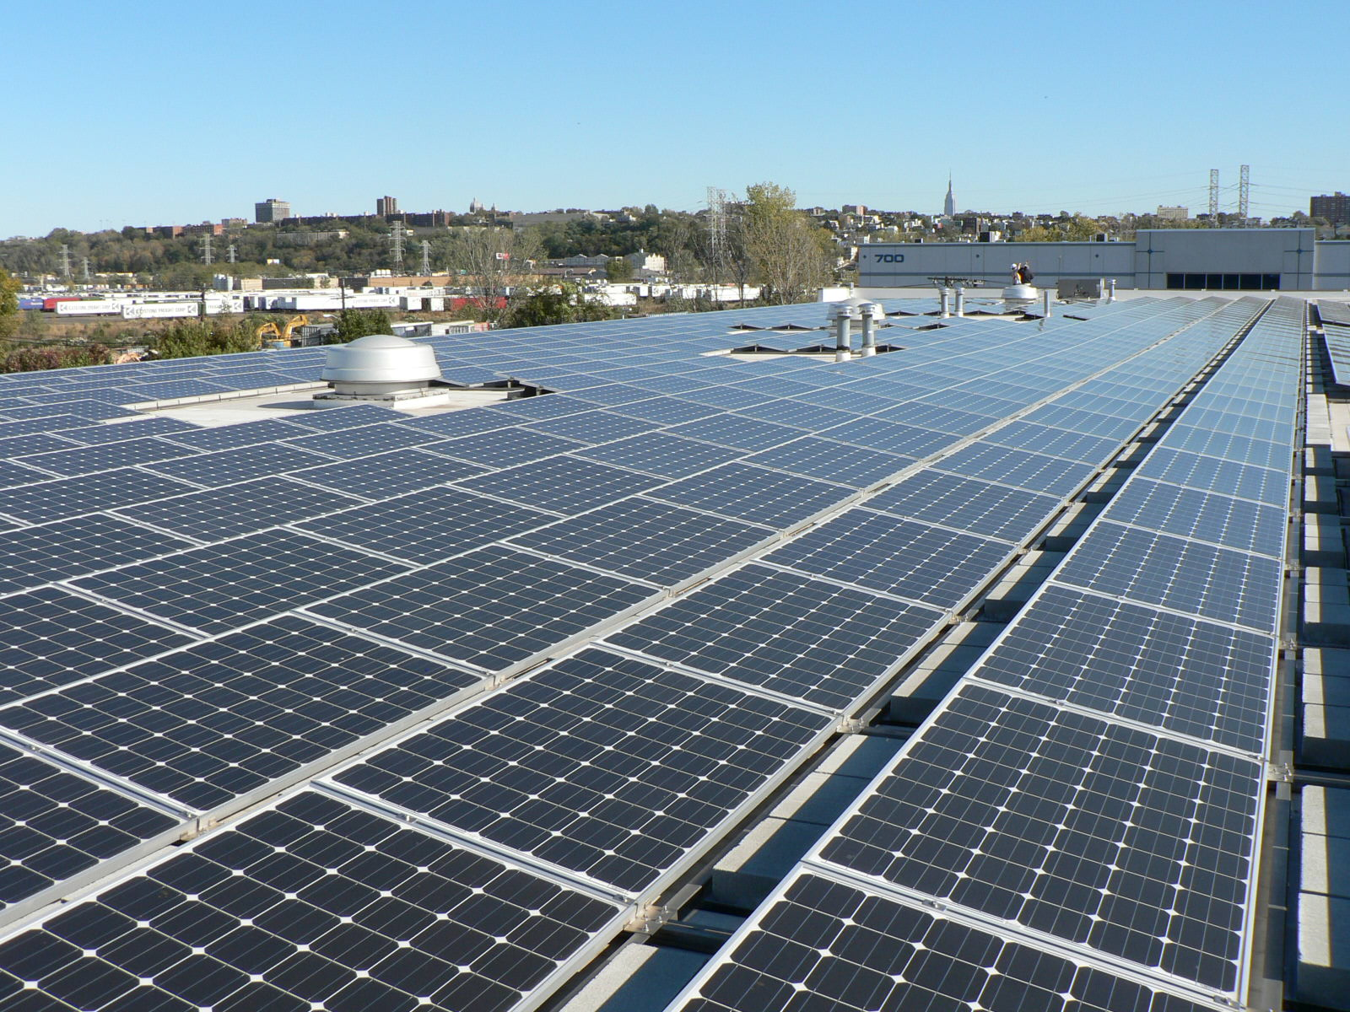
Example: Low-Tilt, Ballasted Racking System
18

Slide 19
Example: High-Tilt, Ballasted Racking System
19

Slide 20
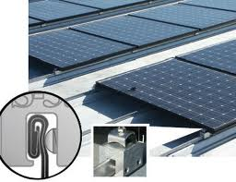
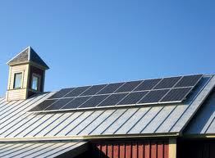
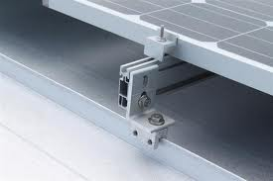
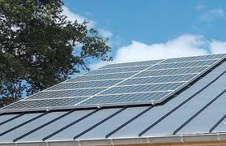
Installation Examples
Rooftop
Penetrating
Ballasted
Standing-Seam
Laminate
Carport/Shade Structure
Fixed-tilt
Tracking
Ground-mount
Fixed-tilt
Tracking
Floating
Building-Integrated PV (BIPV)
20

Slide 21
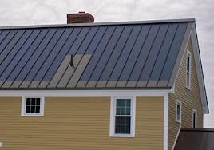
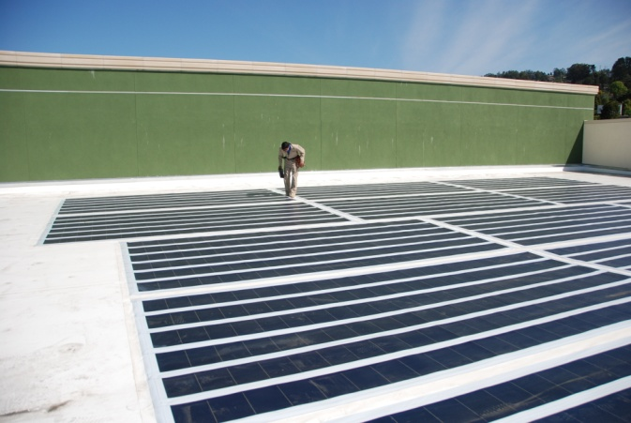
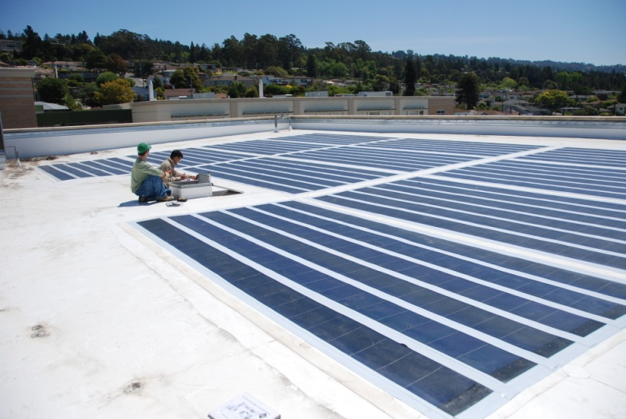
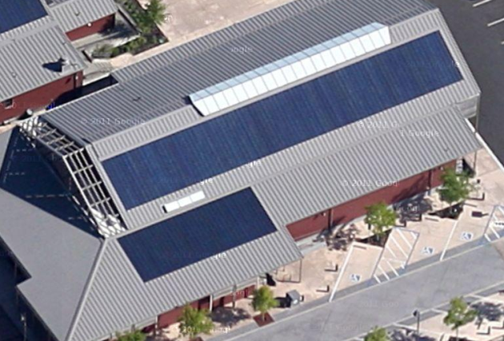
Installation Examples
Rooftop
Penetrating
Ballasted
Standing-Seam
Laminate
Carport/Shade Structure
Fixed-tilt
Tracking
Ground-mount
Fixed-tilt
Tracking
Floating
Building-Integrated PV (BIPV)
21

Slide 22
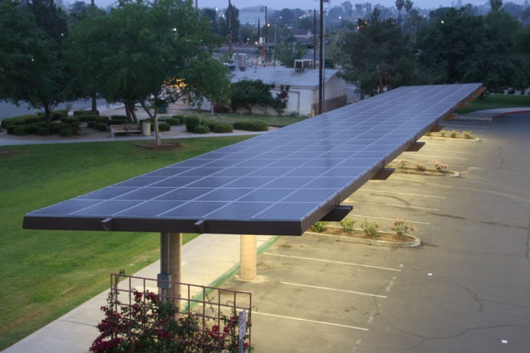
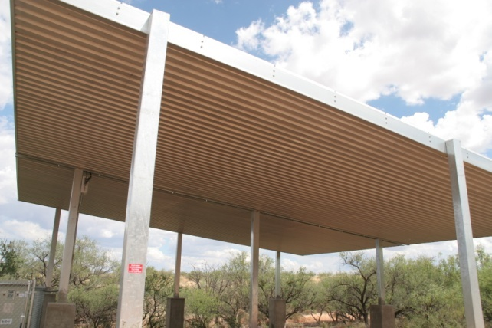
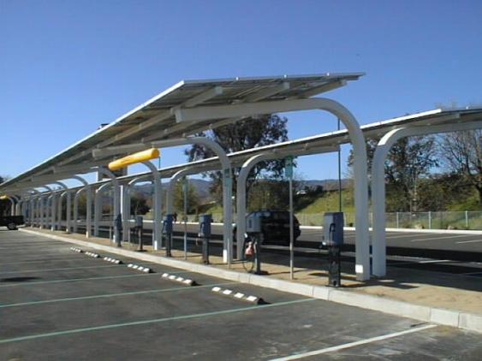
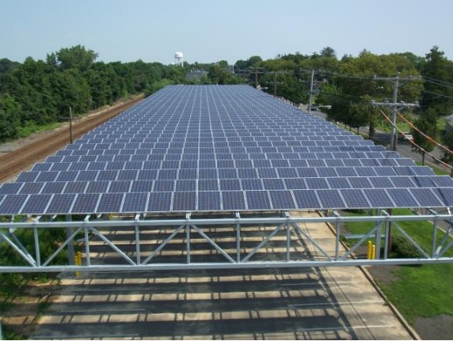
Installation Examples
Rooftop
Penetrating
Ballasted
Standing-Seam
Laminate
Carport/Shade Structure
Fixed-tilt
Tracking
Ground-mount
Fixed-tilt
Tracking
Floating
Building-Integrated PV (BIPV)
22

Slide 23
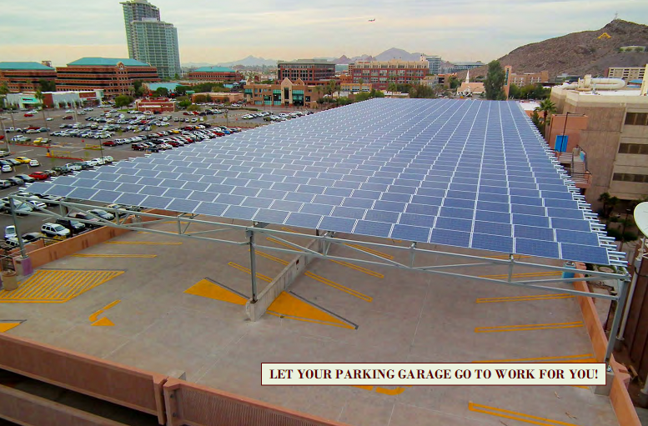
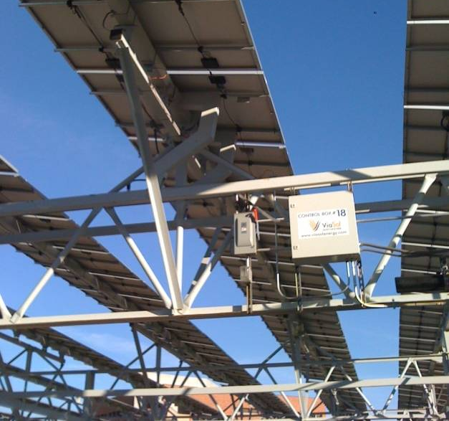
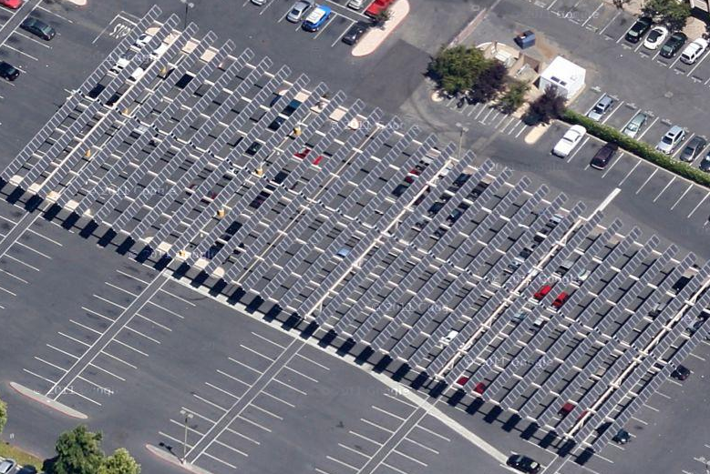
Installation Examples
Rooftop
Penetrating
Ballasted
Standing-Seam
Laminate
Carport/Shade Structure
Fixed-tilt
Tracking
Ground-mount
Fixed-tilt
Tracking
Floating
Building-Integrated PV (BIPV)
23

Slide 24
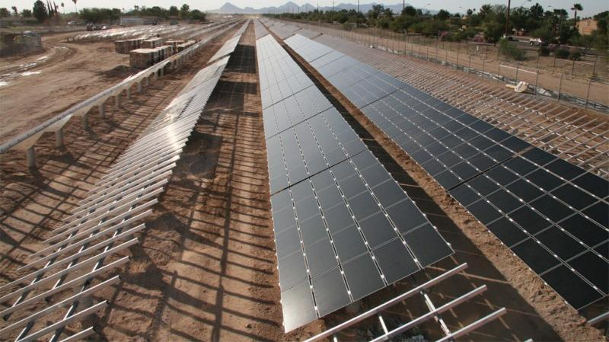
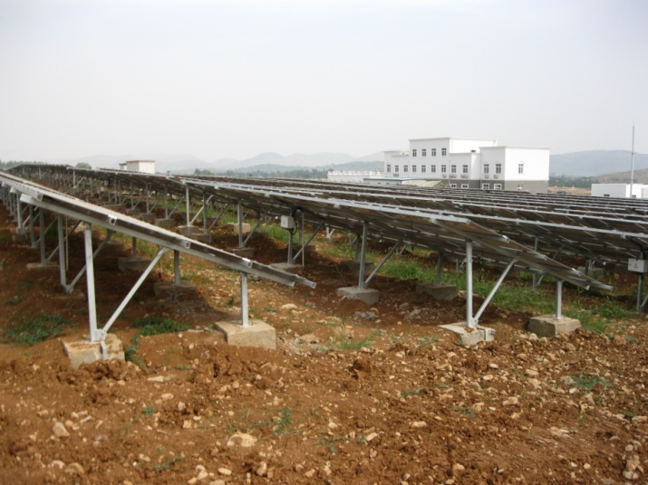
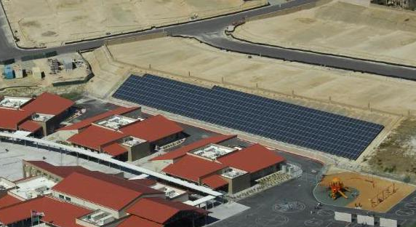
Installation Examples
Rooftop
Penetrating
Ballasted
Standing-Seam
Laminate
Carport/Shade Structure
Fixed-tilt
Tracking
Ground-mount
Fixed-tilt
Tracking
Floating
Building-Integrated PV (BIPV)
24

Slide 25
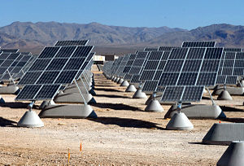
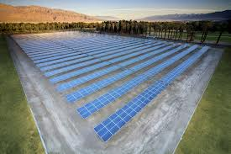
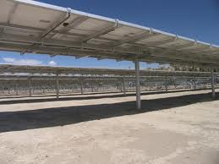
Installation Examples
Rooftop
Penetrating
Ballasted
Standing-Seam
Laminate
Carport/Shade Structure
Fixed-tilt
Tracking
Ground-mount
Fixed-tilt
Tracking
Floating
Building-Integrated PV (BIPV)
25

Slide 26
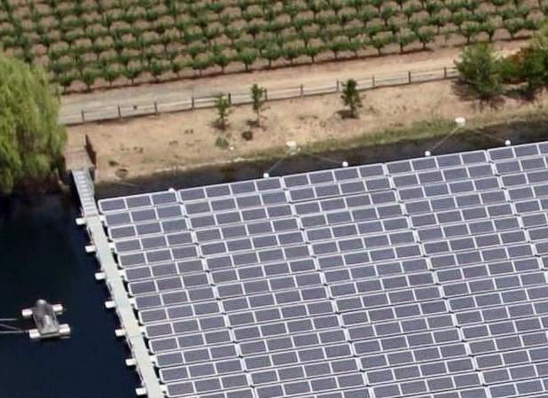
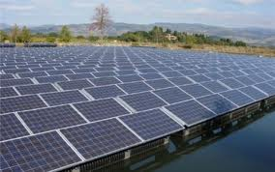
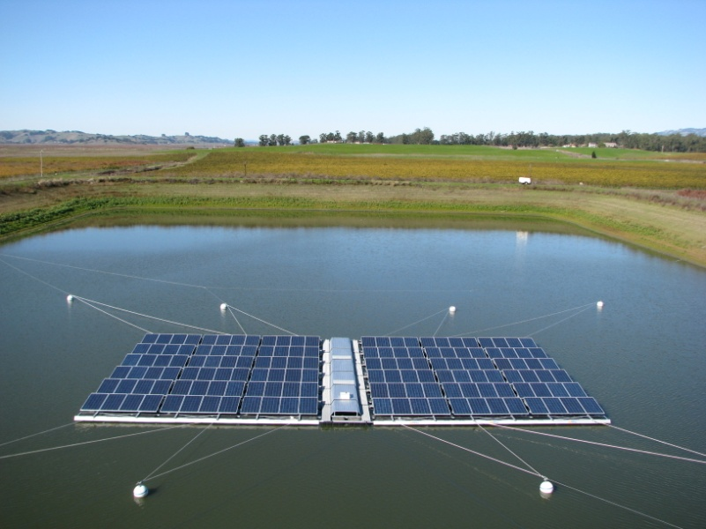
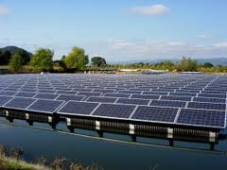
Installation Examples
Rooftop
Penetrating
Ballasted
Standing-Seam
Laminate
Carport/Shade Structure
Fixed-tilt
Tracking
Ground-mount
Fixed-tilt
Tracking
Floating
Building-Integrated PV (BIPV)
26

Slide 27
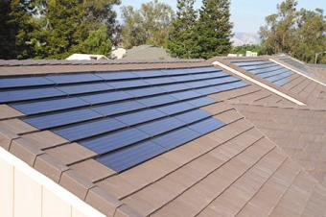
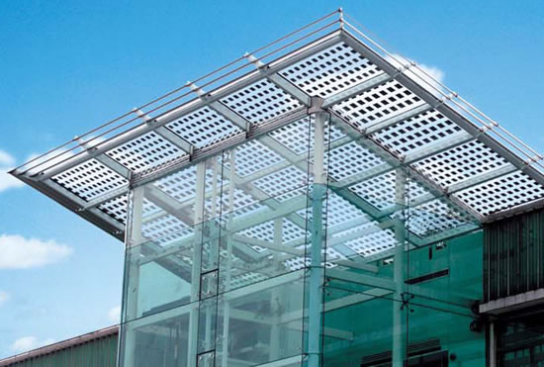
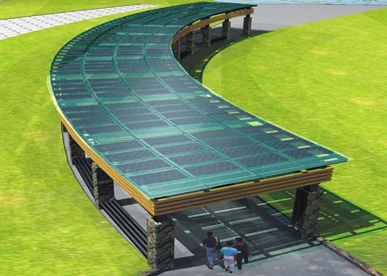
Installation Examples
Rooftop
Penetrating
Ballasted
Standing-Seam
Laminate
Carport/Shade Structure
Fixed-tilt
Tracking
Ground-mount
Fixed-tilt
Tracking
Floating
Building-Integrated PV (BIPV)
27

Slide 28
Solar Project Lifecycle Management
Solar
Strategy
Feasibility
Assessments
Vendor
Procurement
& Financing
Project
Commissioning
System
Optimization
Define Right
Strategic Approach
Find Best
Solar
Sites
Competitive Pricing & Financing Options
Right Components,
Design, Permits,
Construction
Highest
Long-term
Returns
Properly managing all phases of the project will create the greatest long-term value
28

Slide 29
Solar Site Feasibility Checklist
Portfolio approach to site evaluation
On-site survey
Structural, electrical, geotechnical, environmental, shading evaluation
Construction concerns and design considerations
Utility rate evaluation
Review of funding and incentive options
20-year LCOE Financial analysis
Benchmark comparison of pricing & trends
Technical risk assessment
Site specification sheets for RFP
29

Slide 30
Design Considerations: Rooftop
Considerations: Opportunities and Constraints:
Building structural capacity Weight loading; wind loading; seismic
Site-use planning Move or stop operations; re-purpose
Parcel ownership Lease term? Usable? Able to interconnect?
Building orientation South-facing = good; north = not so good
Shading from trees, buildings, power lines Shade kills solar production
Accessibility Expense of construction; operational impact
Roof type Penetrations or ballasted; re-sealing
Rafter spacing and type Weight loading; anchor point locations
HVAC or other rooftop obstacles Parapets? Required walkpads?
Location of interconnection points Electrical, data
Damage or theft hazards Baseball fields? Copper swap meet?
Benefits: Use of available otherwise unused space; CEQA exempt; often hidden from view; more economical; close to interconnection point; typically more secure areas.
30

Slide 31
Design Considerations: Carports
Considerations: Opportunities and Constraints:
Site-use planning Move or stop operations; re-purpose
Parcel ownership Usable? Able to interconnect?
Parking lot orientation South-facing = good; north = not so good
Snow load Weight, clearance, clearing
Shading from trees, buildings, power lines Shade kills solar production
Accessibility Vehicle heights; operational impact
Soils report Water table; rock
Obstacles Trees; light poles; grass/bio-swales; utility lines
Structure type Fixed-tilt; tracking; “blanket”; height
Location of interconnection points Electrical, data; trenching
Aesthetics Paint; structure; trim
Additional uses Shade; rain-proof?; truck wash; lighting
Damage or theft hazards Baseball fields? Copper swap meet?
Benefits: Use of available space; CEQA exempt; secondary goals; high-visibility “green” project; often close to interconnection point.
31

Slide 32
Design Considerations: Ground-Mounts
Considerations: Opportunities and Constraints:
Site-use planning Move or stop operations; re-purpose; CEQA
Parcel ownership Usable? Able to interconnect?; setbacks
Slope orientation South-facing = good; north = not so good
Snow load Weight, clearance, clearing
Shading from trees, buildings, power lines Shade kills solar production
Accessibility Roads, slope
Soils report Water table; rock; brownfield?
Obstacles Trees; grass/bio-swales; protected areas
Structure type Fixed-tilt (ballasted, drilled, driven); tracking
Location of interconnection points Electrical, data; trenching
Damage or theft hazards Baseball fields? Copper swap meet?
Extra maintenance Weed abatement; dirty locations
Benefits: Use of available space (brownfields); typically low visual-impact areas; more economical; greater viability of tracker systems.
32

Slide 33
Project Management & Commissioning
Contract and scope review
Design and engineering review
CEQA compliance
Materials acceptance
Permitting
Rebates and interconnection application
Schedule and operational impacts
Crew safety and accessibility
Line locating
Special inspections
Drilling/trenching/boring
Interconnection and shut-down
Aesthetic issues
Inspection and PTO
As-Builts and staff training
Data connection, monitoring, kiosk
Independent performance verification
Production and component requirements
System sizing; code compliance
Categorical Exemptions, Mitigated Neg Dec
Stainless, galvanized, painted, Al, fiberglass
Building, Planning, Fire
PG&E (no more CSI)
Planning
Focus and logistics
SAFETY
Underground, welding, concrete, roof
Operational impacts
Operational impacts
Paint, design, trim
Building Dept and PG&E
String charts, emergency operations
Internet monitoring and public access
Confirm expected performance
33

Slide 34
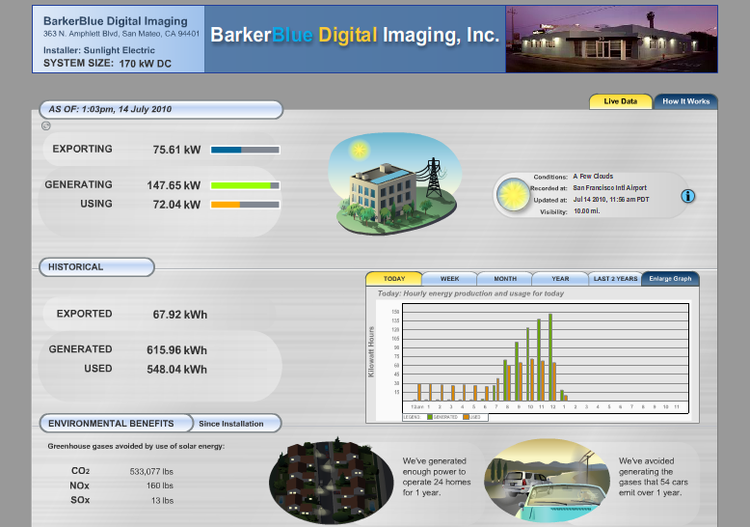
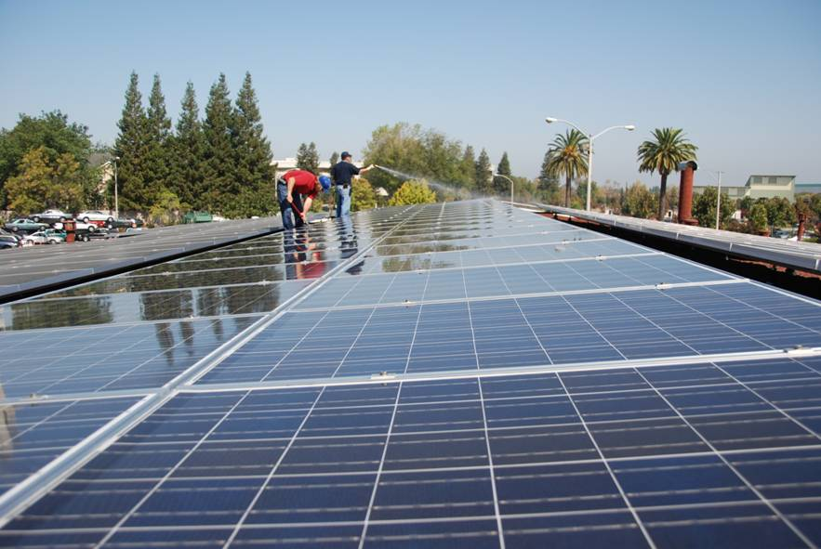
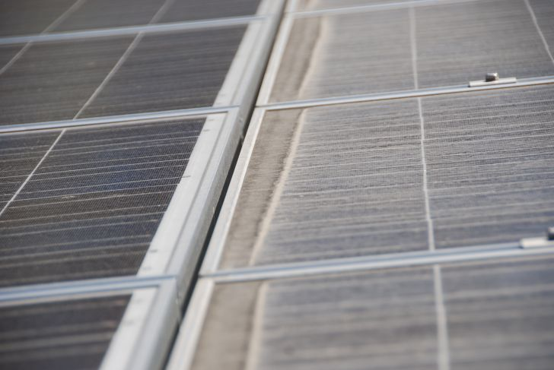
Operations & Maintenance Issues
Performance Management:
Monitoring
On-site irradiance and power measurements
On-line system monitoring
Purchase or Lease
Self-perform
Installer or 3rd-party O&M
Power Purchase Agreement
Owner/installer
Cleaning & Inspection:
Module cleaning
Inverter cleaning
Fuse and wiring check
34

Slide 35
Next Steps
Identify sites for SEED Fund pre-screen review
Sign Memorandum of Understanding
Coordinate site visit(s) for full feasibility assessment
Attend workshops
Provide site information (as-builts, energy usage)
Review site assessments and select sites for RFP inclusion
Participate in vendor selection and contract term negotiation

Slide 36
Contact Information
SEED Team
Meredith Anderson meredith@sierranevadaalliance.org
Sam Ruderman samruderman@sierranevadaalliance.org
Ray Jarvis rjarvis@cityofslt.us
Nathan McKenzie nathan@seiinc.org
Jonathan Whelan jonathan.whelan@optonyusa.com
Sam Hill-Cristol sam.hill-cristol@optonyusa.com
Sierra Business Council
Paul Ahrns pahrns@sierrabusiness.org
Simone Cordery-Cotter scordery-cotter@sbcouncil.org

